Slide 1
Linear Regression & Correlation
Tom Vanasse

Slide 2
History
An examination of publications of Sir Francis Galton (1822-1911) and Karl Pearson (1857-1936) revealed that Galton's work on inherited characteristics of sweet peas led to the initial conceptualization of linear regression.¹
Subsequent efforts by Galton and Pearson brought about the more general techniques of multiple regression and the product-moment correlation coefficient.

Slide 3
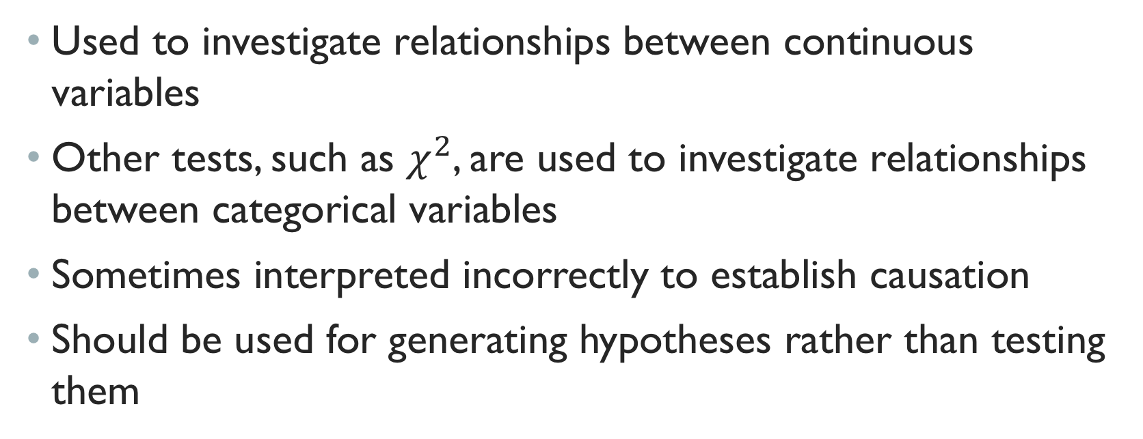
Correlation
Used to investigate relationships between continuous variables
Other tests, such as $χ^{2}$, are used to investigate relationships between categorical variables
Sometimes interpreted incorrectly to establish causation
Should be used for generating hypotheses rather than testing them

Slide 4
Regression
Also used to investigate relationships between continuous variables
Allows assessment of strengths of relationships in the data
Also allows determination of uncertainties in the models using confidence intervals

Slide 5
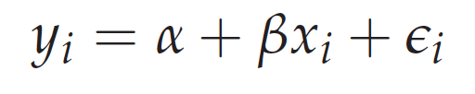
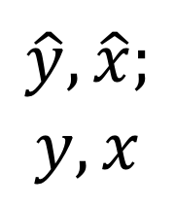
Regression
$$\hat{y}, \hat{x};$$
$$y,x$$

Slide 6
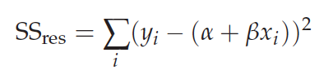
Least SquAres FitTING
Reducing “error”, as measure by the summation of squared residuals

Slide 7
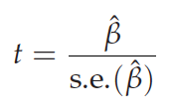
significance
It is usually of prime interest to test the null hypothesis that b = 0 since that would imply that the line was horizontal and thus that the ys have a distribution that is the same, whatever the value of x. You can compute one-sample t -test for that hypothesis simply by dividing the estimate by its standard error
line 24

Slide 8
Assumptions for Linear Regression
Linearity of the relationship between dependent and independent variables
Independence of the errors (no serial correlation)
Normality of the error distribution.
Homoscedasticity (constant variance) of the errors

Slide 9
Anscombe's quartet
Comprises four datasets that have nearly identical simple descriptive statistics, yet appear very different when graphed.
Always plot the data!
https://en.wikipedia.org/wiki/Anscombe%27s_quartet#/media/File:Anscombe%27s_quartet_3.svg

Slide 10
Independence of Errors
Independence of the errors (no serial correlation)
serial – here refers to time or space!
i.e., one error isn’t influenced by the previous error

Slide 11
Reference 2

Slide 12
Independence of Errors
Reference 3

Slide 13
Independence OF ERRORs

Slide 14
Normality
Reference 2

Slide 15
Homoscedasticity
That's a basic visual diagnostic of the spread of standardized (for model-variance) residuals against fitted values, which is suitable for seeing if there's variability related to the mean (not already accounted for by the model). If the assumption of homoscedasticity is true, we should see roughly constant spread. In this case the indication of increase with fitted values is fairly mild.

Slide 16
Reference 2

Slide 17
Cooks Distance
Data points with large residuals (outliers) and/or high leverage may distort the outcome and accuracy of a regression. Cook's distance measures the effect of deleting a given observation. Points with a large Cook's distance are considered to merit closer examination in the analysis.

Slide 18
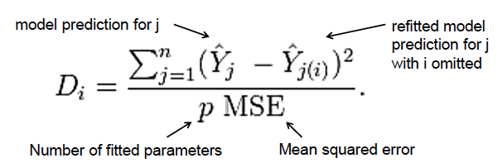
Cooks Distance

Slide 19
Reference 2
Line x

Slide 20
Confidence & PREdiction intervals
Both confidence intervals and prediction intervals in regression take account of the fact that the intercept and slope are uncertain - you estimate the values from the data, but the population values may be different (if you took a new sample, you'd get different estimated values).

Slide 21
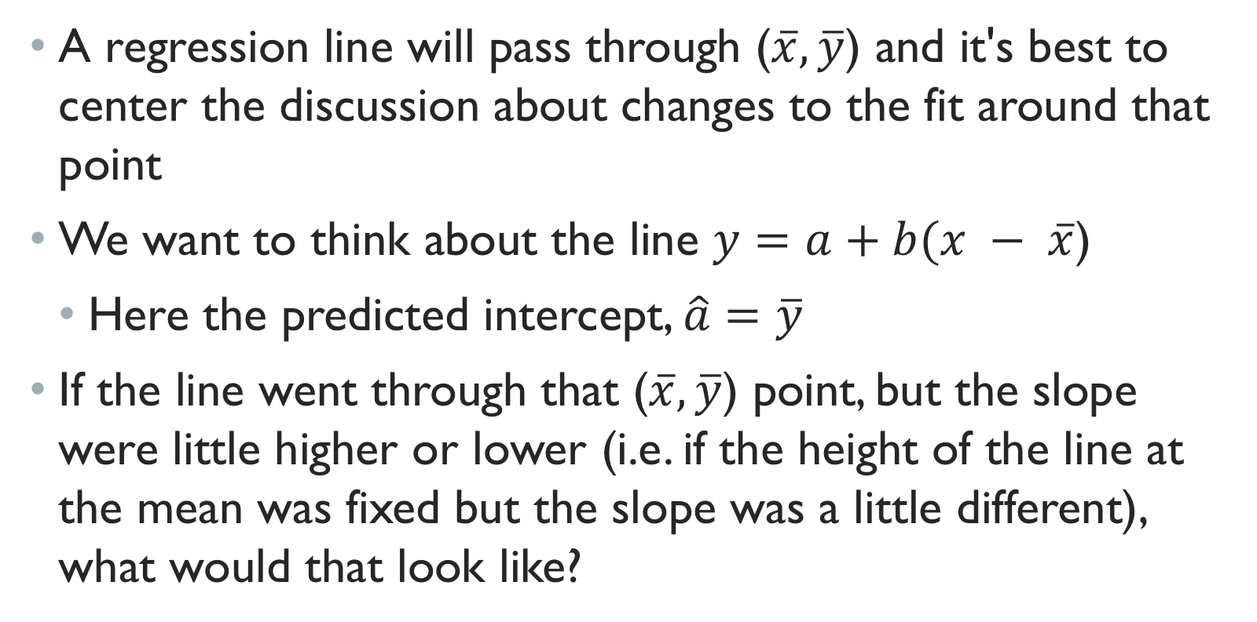
Mean
A regression line will pass through ($\overline{x},\overline{y}$) and it's best to center the discussion about changes to the fit around that point
We want to think about the line $y=a+b(x − \overline{x}$)
Here the predicted intercept, $\hat{a}=$ $\overline{y}$
If the line went through that ($\overline{x},\overline{y}$) point, but the slope were little higher or lower (i.e. if the height of the line at the mean was fixed but the slope was a little different), what would that look like?

Slide 22
Reference 2

Slide 23
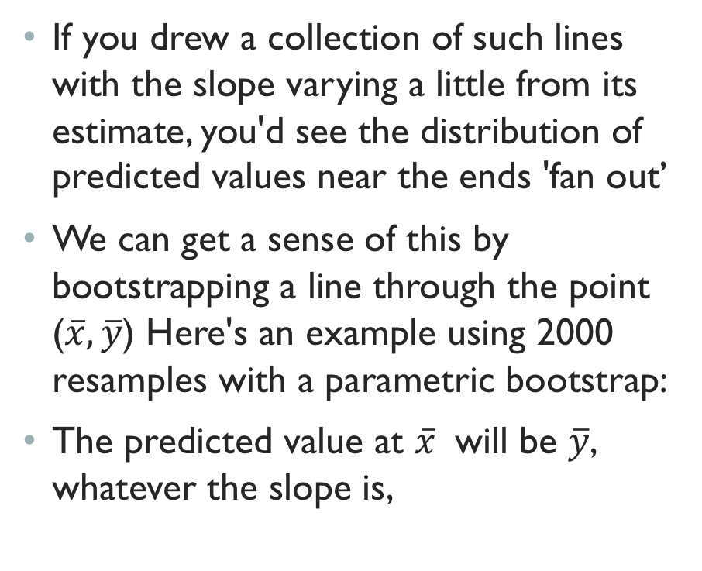
If you drew a collection of such lines with the slope varying a little from its estimate, you'd see the distribution of predicted values near the ends 'fan out’
We can get a sense of this by bootstrapping a line through the point ($\overline{x},\overline{y}$) Here's an example using 2000 resamples with a parametric bootstrap:
The predicted value at $\overline{x}$ will be $\overline{y}$, whatever the slope is,
Reference 2

Slide 24
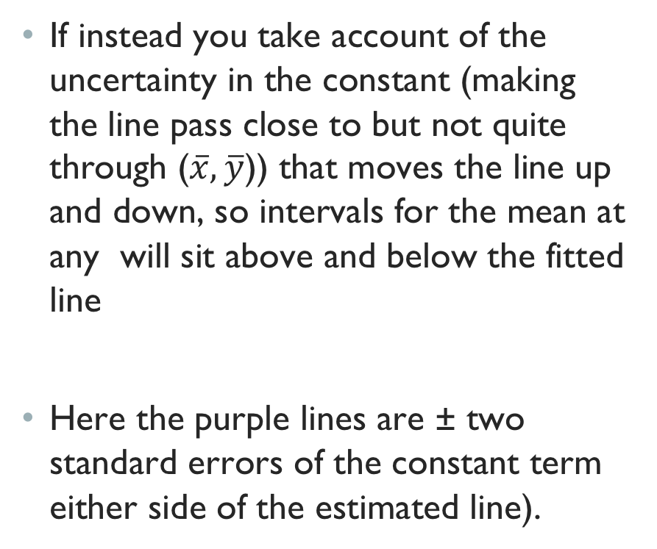
If instead you take account of the uncertainty in the constant (making the line pass close to but not quite through ($\overline{x},\overline{y}$)) that moves the line up and down, so intervals for the mean at any will sit above and below the fitted line
Here the purple lines are ± two standard errors of the constant term either side of the estimated line).
Reference 2

Slide 25
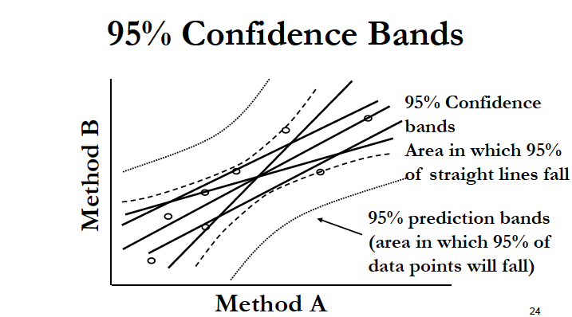

Slide 26
Deming Regression
Deming regression, named after W. Edwards Deming, differs from the simple linear regression in that it accounts for errors in observations on both the x- and the y- axis

Slide 27
Deming Regression
x*,y* denotes “true” values of regression, x,y are observed values.
Ratio of variances (default is one):

Slide 28
Correlation

Slide 29
Pearson Correlation
In some experiments, two variables are measured that change together, however neither can be considered to be the dependent variable
The correlation coefficient is a number between -1 and +1 that describes the strength of this association

Slide 30
Pearson Correlation
Most commonly used
Quantifies the strength of association between two variables that are normally distributed:

Slide 31
Alternatively, the mean product of standard scores

Slide 32
Coefficient of Determination (Explained Variance)

Slide 33
CORRELATION VS. regression
Correlation calculations do not find a best fit line but quantify how much one variable changes with another.
It doesn’t matter which variable is X and which is Y, the correlation will be the same.
Linear regression finds the line that best predicts Y given X.
Choice of which variable to label Y and which to call X will impact the results.

Slide 34
Spearman Correlation,
The Spearman correlation coefficient is defined as the Pearson correlation coefficient between the ranked variables.

Slide 35

Monotonicity
It assesses how well the relationship between two variables can be described using a monotonic function.

Slide 36
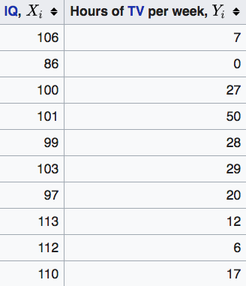
Example

Slide 37
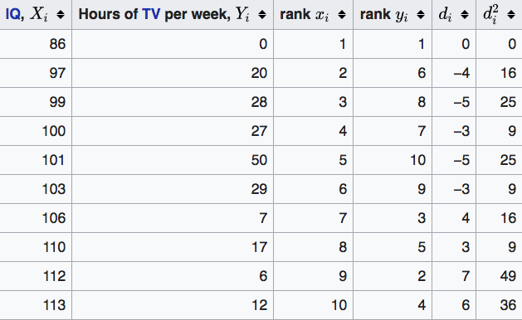
Example
−0.175

Slide 38
Pearson vs. Spearman

Slide 39
Summary
Linear regression allows one to estimate a linear relationship between a dependent and independent variable.
Correlation coefficients allow the assessment of association between two variables if a dependent independent relationship is not evident.
Pearson method is used for numerical data
Spearman method is used for ranked data

Slide 40
References
¹Stanton JM (2001): Galton, Pearson, and the Peas: A Brief History of Linear Regression for Statistics Instructors. Journal of Statistics Education 9:255.
²http://data.library.virginia.edu/diagnostic-plots/
³http://qingkaikong.blogspot.com/2017/01/signal-processing-how-autocorrelation.html
⁴https://stats.stackexchange.com/questions/85560/shape-of-confidence-interval-for-predicted-values-in-linear-regression
https://en.wikipedia.org/wiki/Deming_regression
https://en.wikipedia.org/wiki/Coefficient_of_determination

